Slide 1
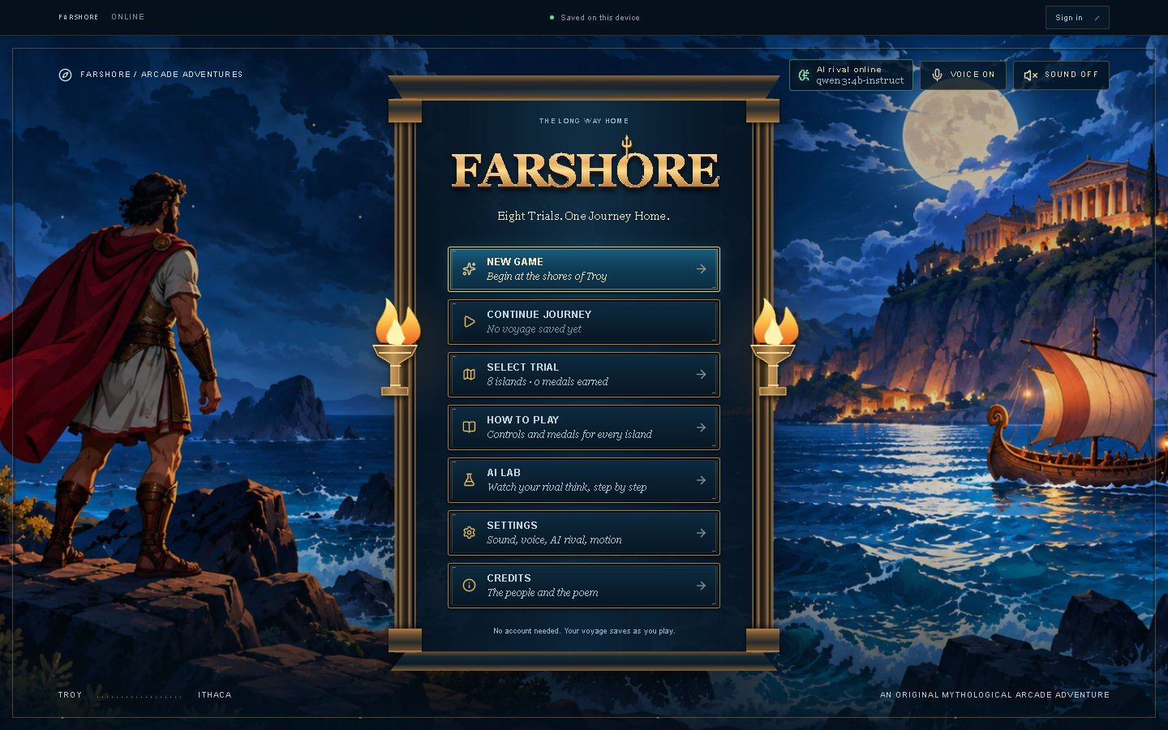
Farshore
Phase 3: UI design, frontend and usability testing
Bibek Pathak · CMPS 4200 HCI: AI-Enhanced UI/UX · November 2026
The title menu of the tested build
Eight trials. One journey home. A mythic rival that a language model plans every round.
Notes:
Hi, I'm Bibek. Farshore is a solo project: an arcade journey home through Homer's Odyssey, where every opponent is planned by a language model. In the next ten minutes: the design system and screens, how the AI feature looks in all five states, how players stay in control of it, the mock AI service I test with, the usability test and its baseline results, and what I fixed. Then a short live demo.

Slide 2
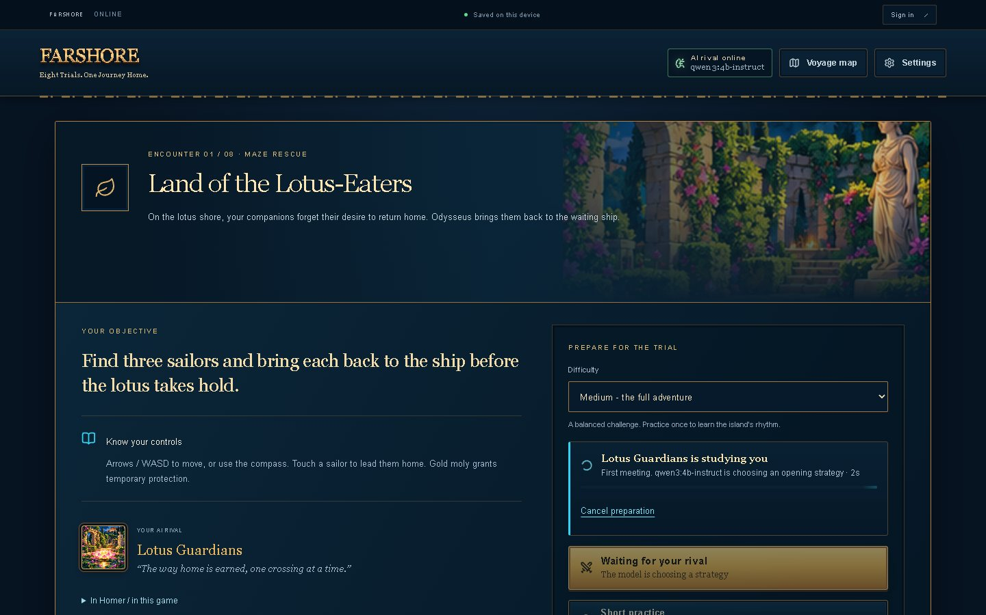
An arcade Odyssey with an AI rival
1
Eight trials, one per episode
Lotus-Eaters maze, Cyclops' Cave runner, Aeolus' winds, Circe's duel, the Sirens, Scylla, Calypso and Ithaca's bow.
2
A model plans every rival
Before each round, Qwen3-4B reads the player's recent attempts and picks the rival's strategy and taunt.
3
The game keeps it fair
Code owns scoring and collisions. The AI's choice is shown, explained and checked before play.
Trial selection, with each trial's AI technique
Notes:
Each of the eight trials is its own small arcade game, one per episode of the Odyssey. The AI part: before every round, a local language model, Qwen3-4B, reads how the player did recently and chooses the rival's strategy and opening taunt. It also writes live commentary. The game code still owns scoring and collisions, so the AI decides how the rival plays, never whether you win. That split is what most of my design decisions protect.

Slide 3
Style basics, defined once in code
Colour
Five text sizes
Spacing scale
Background
#071523
Surface
#0B2033
Aa XS · 12 px
4 px
Aa S · 14 px
8 px
Text
#F6F0E3
Muted text
#93AFC0
Aa M · 16 px
12 px
16 px
Aa L · 24 px
24 px
Accent (gold)
#E9B85C
AI (cyan)
#32D4F5
Aa XL · 40-72 px
32 px
48 px
Error
#F4604F
Success
#9FE6B4
src/styles/tokens.css is the only place these values are defined; every stylesheet reads them. Cyan is kept for the AI, so "the rival is thinking" never looks like danger.
Notes:
Before the screens I fixed the style basics: a navy background, cream text, one accent, gold, for everything you can press, plus error red and success green. Cyan is reserved for the AI only, so the rival thinking never reads as danger. Four font families, five text sizes, and one spacing scale. In code these live in a single tokens file, and every stylesheet reads from it, so the Figma frames and the build use the same values.

Slide 4
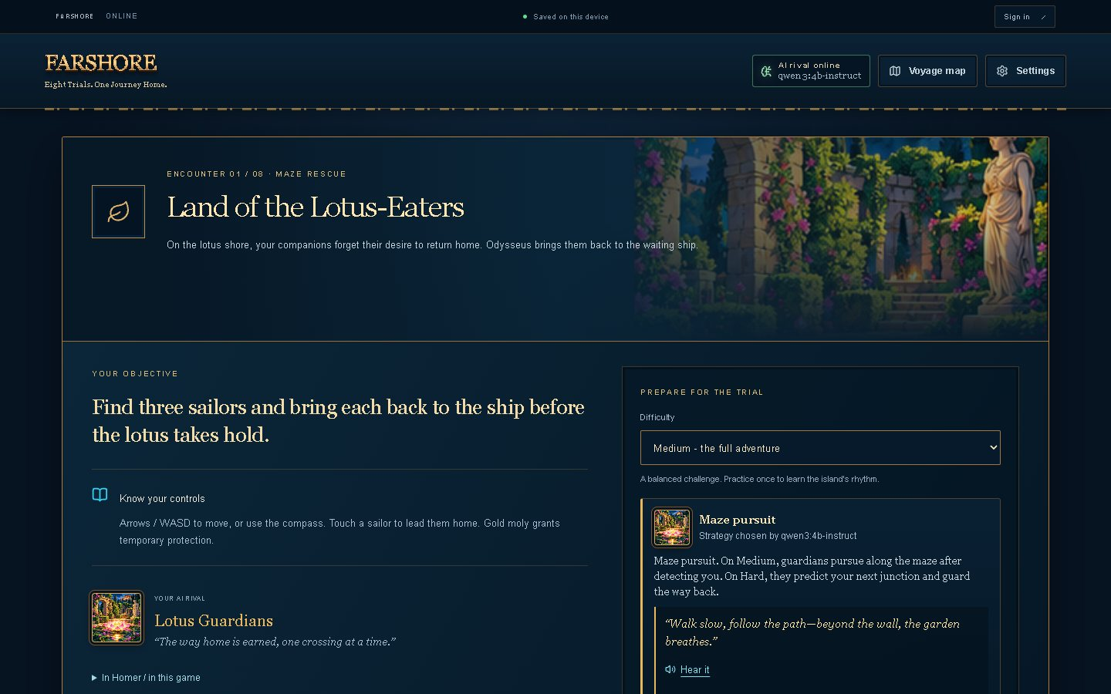
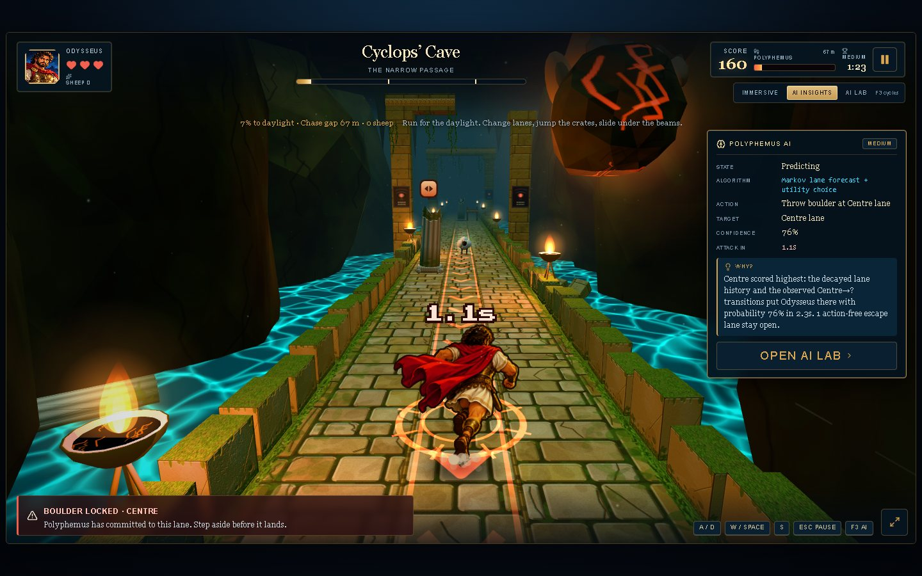
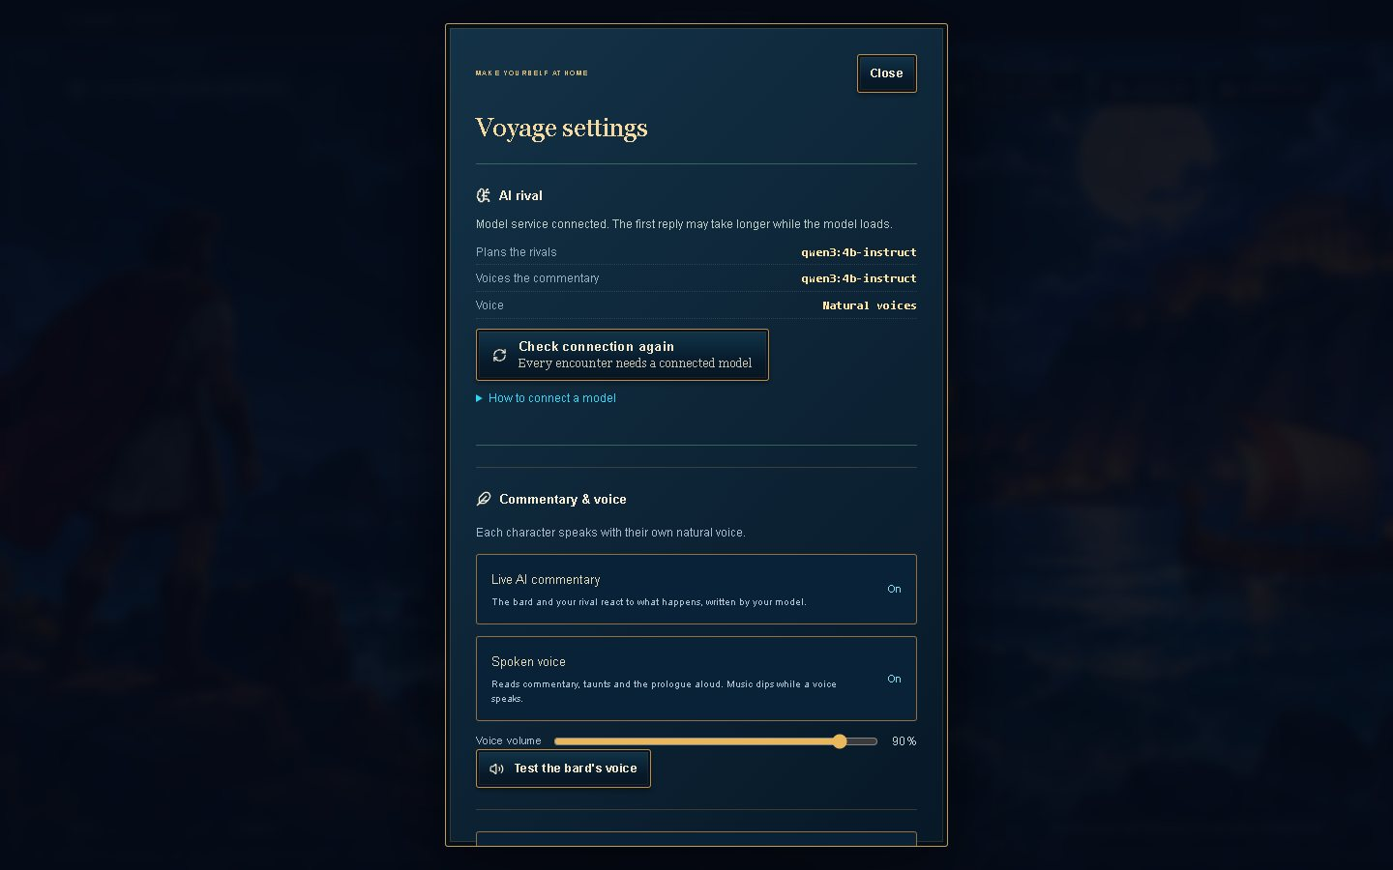
Core screens built from the Phase 2 site map
29
annotated frames in the Figma file: 25 desktop, 4 phone
F1 Start
F2 Choose a trial
F3 Prepare the rival
F4 Play
F5 Understand the rival
F6 Settings
F7 Account
Title menu
Briefing: strategy ready
Cyclops' Cave with AI Insights
Settings: AI status and controls
Notes:
These are four of the core screens, captured from the running game. The build covers every flow from the Phase 2 site map, F1 to F7. The Figma file has 29 annotated frames: real captures with numbered notes, gold for interface decisions and cyan for AI behavior. The briefing, top right, is where the AI feature lives, so the next two slides zoom in on it.

Slide 5
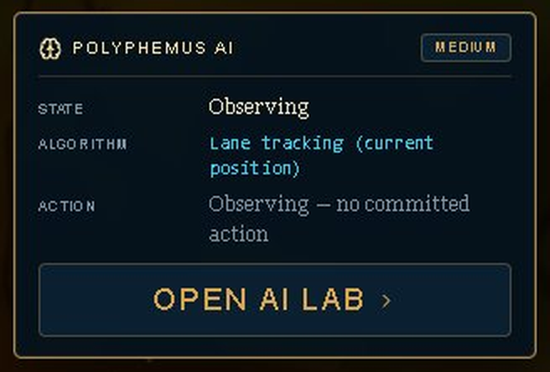
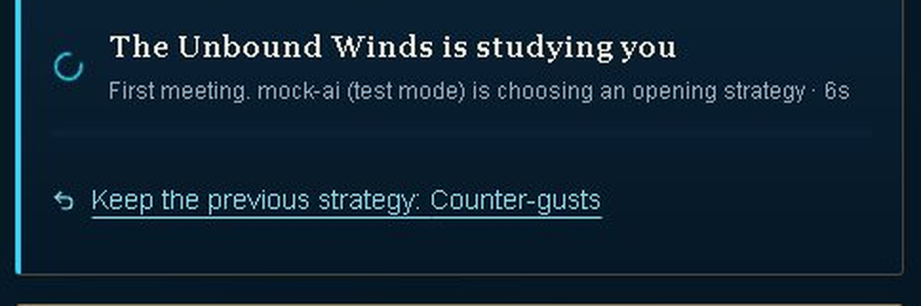
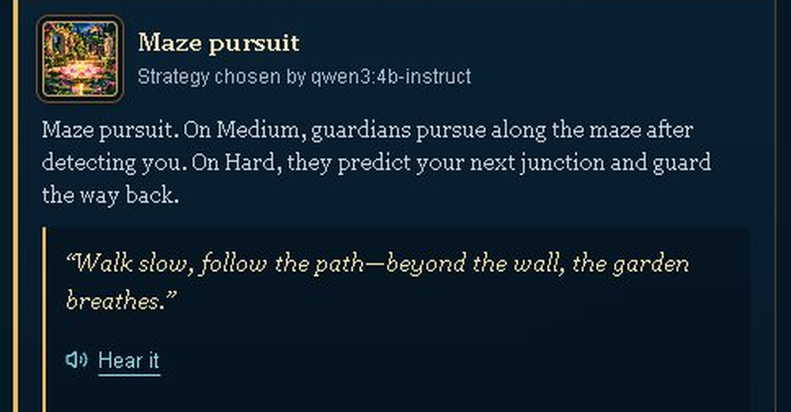
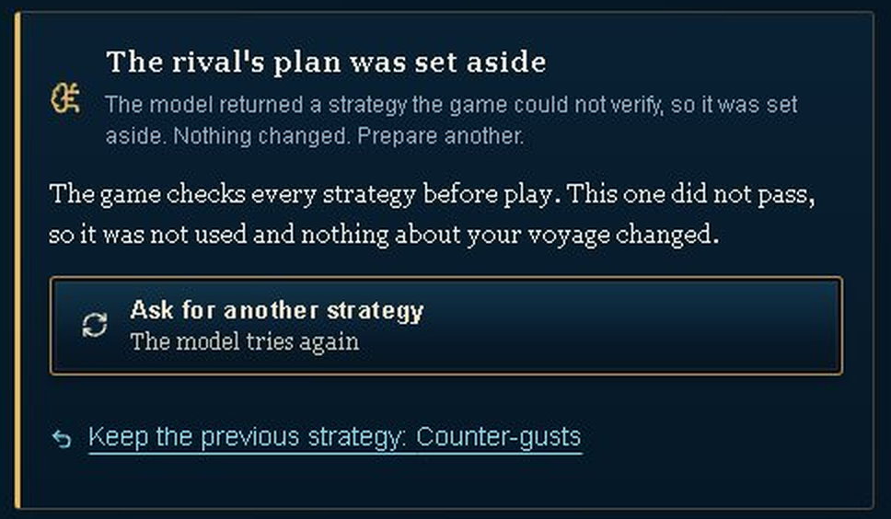
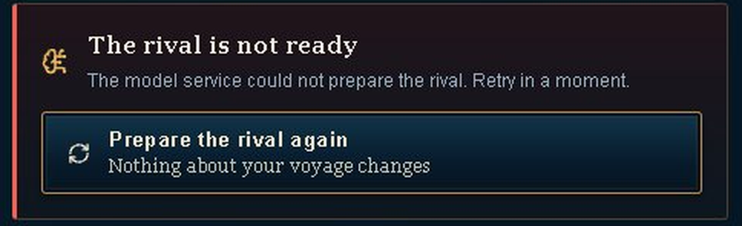
The rival's strategy in all five states
1
Empty
2
Loading
3
Success
AI Insights before the rival commits: "no committed action".
Elapsed seconds, no fake progress bar. Measured: 7-12 s.
The strategy, the model that chose it, and the rival's taunt.
4
Low confidence
5
Error
HOW THESE WERE MADE
From the running game
States 4 and 5 were triggered with the mock AI service. Success shows the live model, qwen3:4b-instruct.
Failed the game's checks, so it was set aside. Amber, not red.
A plain message and one recovery action. Nothing is lost.
Notes:
The main AI feature is the rival's strategy, designed in all five states. Empty: before the rival has committed to anything, the AI Insights panel says so honestly instead of inventing a reason; the briefing itself skips an empty box and opens straight into loading. Loading: I show elapsed seconds, not a fake progress bar, because model time varies; in my Phase 2 spike it took 7 to 12 seconds. Success names the strategy and who chose it. Low confidence is new: if the model's plan fails the game's checks it is set aside, in amber rather than red, because nothing is broken. Error gives a plain message and one recovery button.

Slide 6
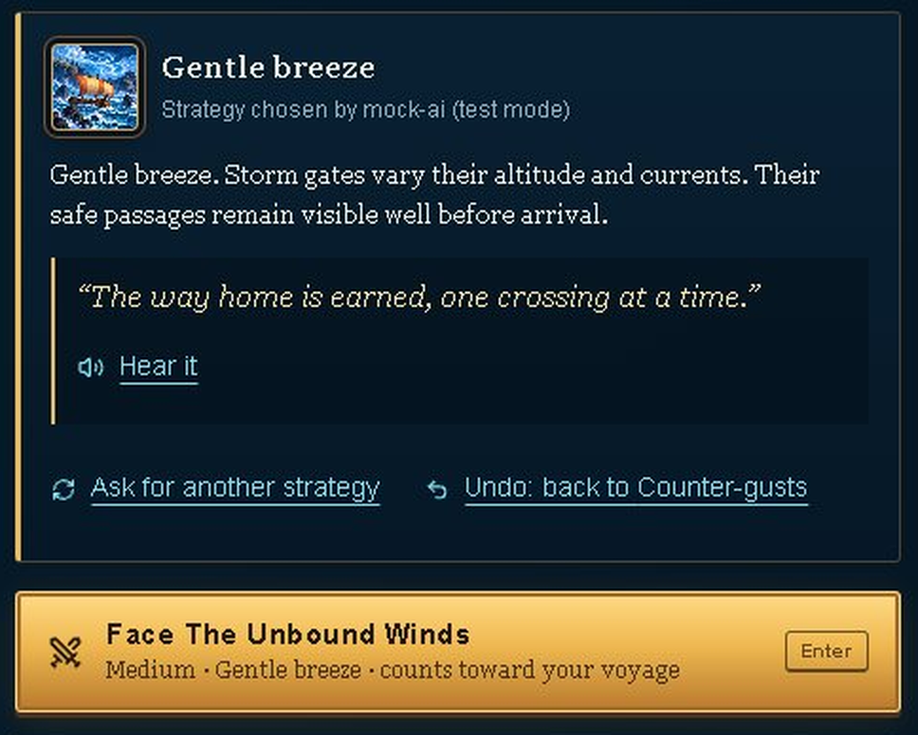
Players stay in control of the AI's choice
1
Regenerate
"Ask for another strategy": the model chooses again.
2
Undo
Go back to the previous strategy, even while a new one loads or if it fails.
3
Reject
The game rejects plans that fail its checks. Commentary and voice can be switched off.
4
Cancel
Stop a request that is taking too long.
5
Edit: not offered
The strategy is the opponent's move. Changing difficulty asks for a new one.
Notes:
Players can act on the AI's result. Ask for another strategy regenerates it. New this phase is undo: after asking again you can go back to the strategy you had, and if the new request is slow, fails or is set aside, Keep the previous strategy is one click away. The game itself rejects plans that fail its checks, and players can switch the commentary off. I deliberately don't let players edit the strategy, because it is the opponent's move; changing difficulty asks for a new one instead.

Slide 7
A mock AI service tests every state on demand
mock-ai.ts (test mode)
success 1.5 s · slow 12 s · uncertain · error · offline. "-once" modes fail once, then recover.
Game interface
model-api.ts
Briefing, rival panel, live commentary
One module for every AI call
Live model
Qwen3-4B through Ollama, or a hosted provider for signed-in players
Switch from a second tab: localhost:3000/api/ai-mock?mode=error-once
Slow mode is 12 s, just above the slowest measured response (11.6 s). Task 4 of the test uses error-once to cause an AI failure without warning.
Notes:
Every AI call goes through one module. It asks the mock service first: in test mode the mock answers with success, a slow response, an uncertain plan, an error or offline, and the model is never called. I switch modes from a second browser tab, which is how Task 4 of my test leads people into an AI error without warning. My live model is already connected, so in Phase 4 the mock stays as the test fixture for these states rather than being replaced.

Slide 8
What changed since the Phase 2 wireframes
A1
A5
A7
Five trials became eight
Explainable AI Insights
Full-screen play stage
Follows the Odyssey's route, with one game per episode.
Players see why the rival acted, and that it cannot attack unfairly.
The small embedded canvas competed with the page around it.
A2
A15-A16
A14, A17
The AI rival is required
Low confidence and undo
Mock service and tokens
The opponent is the core experience; a clear offline state replaces the toggle.
A doubtful plan no longer looks like an outage, and asking again can be undone.
Every AI state can be tested on demand; style values are defined once.
Notes:
Since the Phase 2 wireframes: five trials became eight, following the Odyssey's route. To answer the Phase 2 trust question, the AI Insights panel shows why the rival acted. The small canvas became a full-screen stage. The AI rival became required, with a clear offline state. And for this phase I added the low-confidence state, undo, the mock service and the design tokens. The full list, with reasons, is in the PDF.

Slide 9
Usability test: four tasks, one script for everyone
T1
from F1
T2
from F2
T3
from F3
T4
from F4
Start your journey
Know your opponent
Read the rival's mind
AI failure
Reach the first trial's briefing
Explain the strategy, and that the AI chose it
Cite a reason from AI Insights while playing
Recover from an AI error without help
Mock error, no warning
Measures
Success: Yes / Partly / No / Gave up
Time on task
Ease 1-5
SUS, 10 items
AI trust 1-5, with why
5-6 adults new to Farshore · think aloud · consent read first, no recording without permission · about 20 minutes · the same script in Phase 5
Notes:
I tested with the instructor's script template, filled in, and the same script for every participant. Four tasks from my primary flows: start the journey, find out what the opponent plans and who decided it, explain one of the Cyclops' moves using AI Insights, and Task 4, where the mock service makes the AI fail without warning and I watch whether people notice and recover. I recorded success, time, a 1-to-5 ease rating, SUS after the session, and an AI trust rating with the reason. Phase 5 repeats exactly this.

Slide 10
Baseline results
Task | Success (Yes) | Median time | Mean ease (1-5)
T1 Start your journey | — | — | —
T2 Know your opponent | — | — | —
T3 Read the rival's mind | — | — | —
T4 AI failure | — | — | not asked
—
SUS mean
out of 100; the average is 68
—
AI trust
mean rating, 1-5
Participants: —
This is the baseline that Phase 5 repeats with the same tasks and measures.
To fill after the sessions, from the workbook's Summary sheet
Notes:
PLACEHOLDER until the sessions are done. These numbers come only from Farshore-Phase-3-Test-Data.xlsx (Summary sheet). Say how many people took part, the success rate and median time for each task, the SUS mean against the average of 68, the AI trust mean and the most common reason for it, and how many recovered in Task 4 without help.

Slide 11
Top issues and what I fixed
Issue | Severity (0-4) | Seen in | Fix
— | — | — | —
— | — | — | —
— | — | — | —
Pilot watch list
From an automated walkthrough before the sessions. Not participant data.
The start button is below the fold at 1440 × 900
The Lotus maze ignores the model's strategy (fix planned after testing)
Cancel preparation starts again at once
To fill after the sessions, with before and after screens
Severity: 0 = not a problem, 4 = usability catastrophe. The worst issues are fixed before the midterm, and the rest are listed for Phase 4.
Notes:
PLACEHOLDER until the sessions are done. Fill the table from the workbook's Issues sheet, and show before and after screens for each fix. The right-hand list is from my automated pilot walkthrough, not from participants: say so, and say which of these participants actually ran into.

Slide 12
Next: Phase 4, then a short demo
Phase 4 plan
Live demo, about 2 minutes
Fix the remaining issues from testing
Move the last off-scale styles onto the tokens
Phone: show AI Insights beside the play area
Keep the mock as the test fixture for every AI state
Phase 5: repeat the same tasks and measures
1
New game, then the first briefing
2
The rival panel: strategy and who chose it
3
Ask for another strategy, then Undo
4
Mock error, then Prepare the rival again
5
Cyclops' Cave with AI Insights
Questions?
If the live demo fails: the recorded demo video
Notes:
For Phase 4: fix the remaining issues, finish moving the older styles onto the tokens, and put AI Insights beside the play area on phones. Phase 5 repeats the same test so I can show the improvement. Now a quick demo: start a new game and open the briefing, read the rival's strategy, ask for another and undo it, trigger the mock error and recover, and finish in the Cyclops' Cave with AI Insights. If anything fails, I have a recorded video. Thank you, happy to take questions.

